Slide 1
Royalty / Rental Income
Pub 4012 Tab D
(Federal 1040-Line 17)
(NJ 1040-Line 22)
Notes:
1

Slide 2
Royalty/Rental Income Schedule E
Royalties can be reported on client’s K-1 or 1099-MISC – IN SCOPE
Rental income for oil leases with no expenses –
IN SCOPE
Rent can be reported on 1099-MISC
Rent reported on K-1 OUT OF SCOPE
Rental income on residential property – OUT OF SCOPE
Enter rents or royalties in Federal section \ Income \ Rents and Royalties (Schedule E). TS transfers to 1040 Line 17
Notes:
Counselors who do a return with rental income on residential property that is Out of Scope can be held liable for any mistakes
2

Slide 3
Special Topics on TaxPrep4Free.org
See TaxPrep4Free.org Preparer page Special Topics documents
“Rent or Royalties on 1099-MISC”
“K-1 Income Entry”

Slide 4
TS – Rents and Royalties Federal section \ Income \ Enter Myself \ Rents and Royalties (Schedule E)
Type of income (from drop-down menu)
Description
Royalty payments received

Slide 5
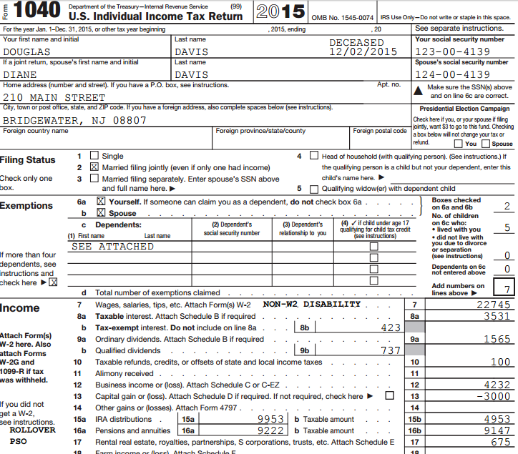
TS - Rent/Royalties on 1040
TS transfers from Schedule E
Notes:
TS transfers total from Schedule E to 1040 Line 17
5

